Slide 1
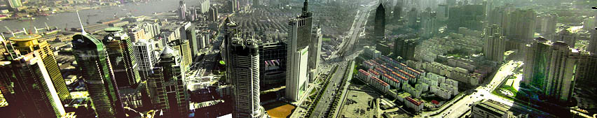
Kingdom and post-Postmodern Megalopolises
In the AD2000 movement, we didn’t think far enough ahead. Locked into people group thinking, US missions strategies were largely irrelevant in the cities.
We also missed the Urban Millenium as it got reduced to a decade. In a decade, cities have already morphed into the era of Megalopolises and Conurbanisations.
A Global extension of data in
Grigg, Viv, (2010) The Spirit of Christ and The Postmodern City, Emeth Press

Slide 2
50 Year Urban Mission Framework: Transformation of the World’s Cities
Mobilize catalytic teams to global slums (1.3 Billion) from West (70’s-90’s)
Catalyse indigenous movements of 10,000 disciples, churches, Bible school in slums of each of 6600 cities (90’s-2015)
Movements engage in significant transformational of slums (95-2020)
As a result, movements for urban transformation sparked among the urban elites (2000-2025)
Transformation of culture, philosophies and structures of conurbanizations (2020-2050) to welcome back the King.
No reflection, no dream:
no dream, no strategy.

Slide 3
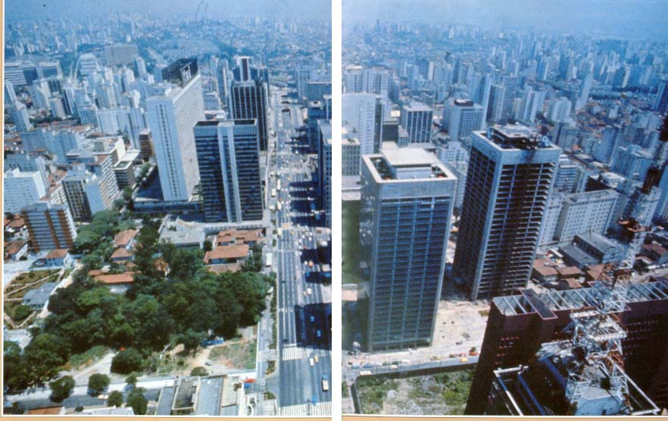
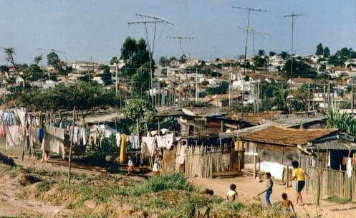
4000 year old Abrahmic dream
The Biblical Tale of Two Cities
He looked forward to a city, whose builder and maker was God
City of Beauty,
Equality, Love
& Prosperity
Our task to bring the city of God into the City of Man

Slide 4
Critical Progressions: Conurbanism
We are past the collapse of Christendom,
past the collapse of Western modernism
  in the no-man’s land of postmodernism
    It’s a divine moment where the future is open to those who will take it
Issues beyond Urbanism: What does
  1. A post-Postmodern Conurbanism look like?
  2. A Kingdom-transformed Megalopolis look like?

Slide 5
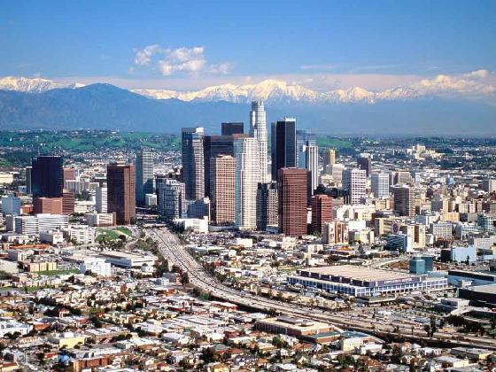
Emergent Polarizations
Socio-geography of post-Postmodern city
Two tiered cities
Stock Exchange
Politico-Economic polarization
Culture of megalopolis
Informal Migrant Economy
Slums
Trailer parks
Multi-family
Politics of Nature
Expansion of Dear, L.A. as Postmodern Urbanism

Slide 6
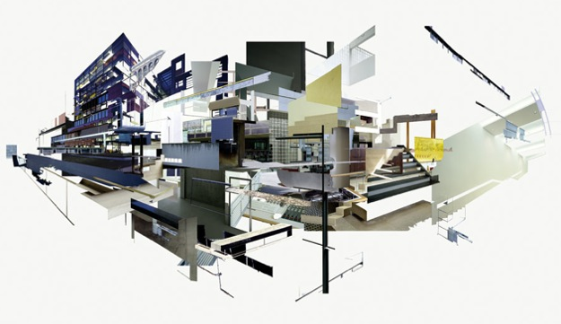
Western Postmodernism

Slide 7
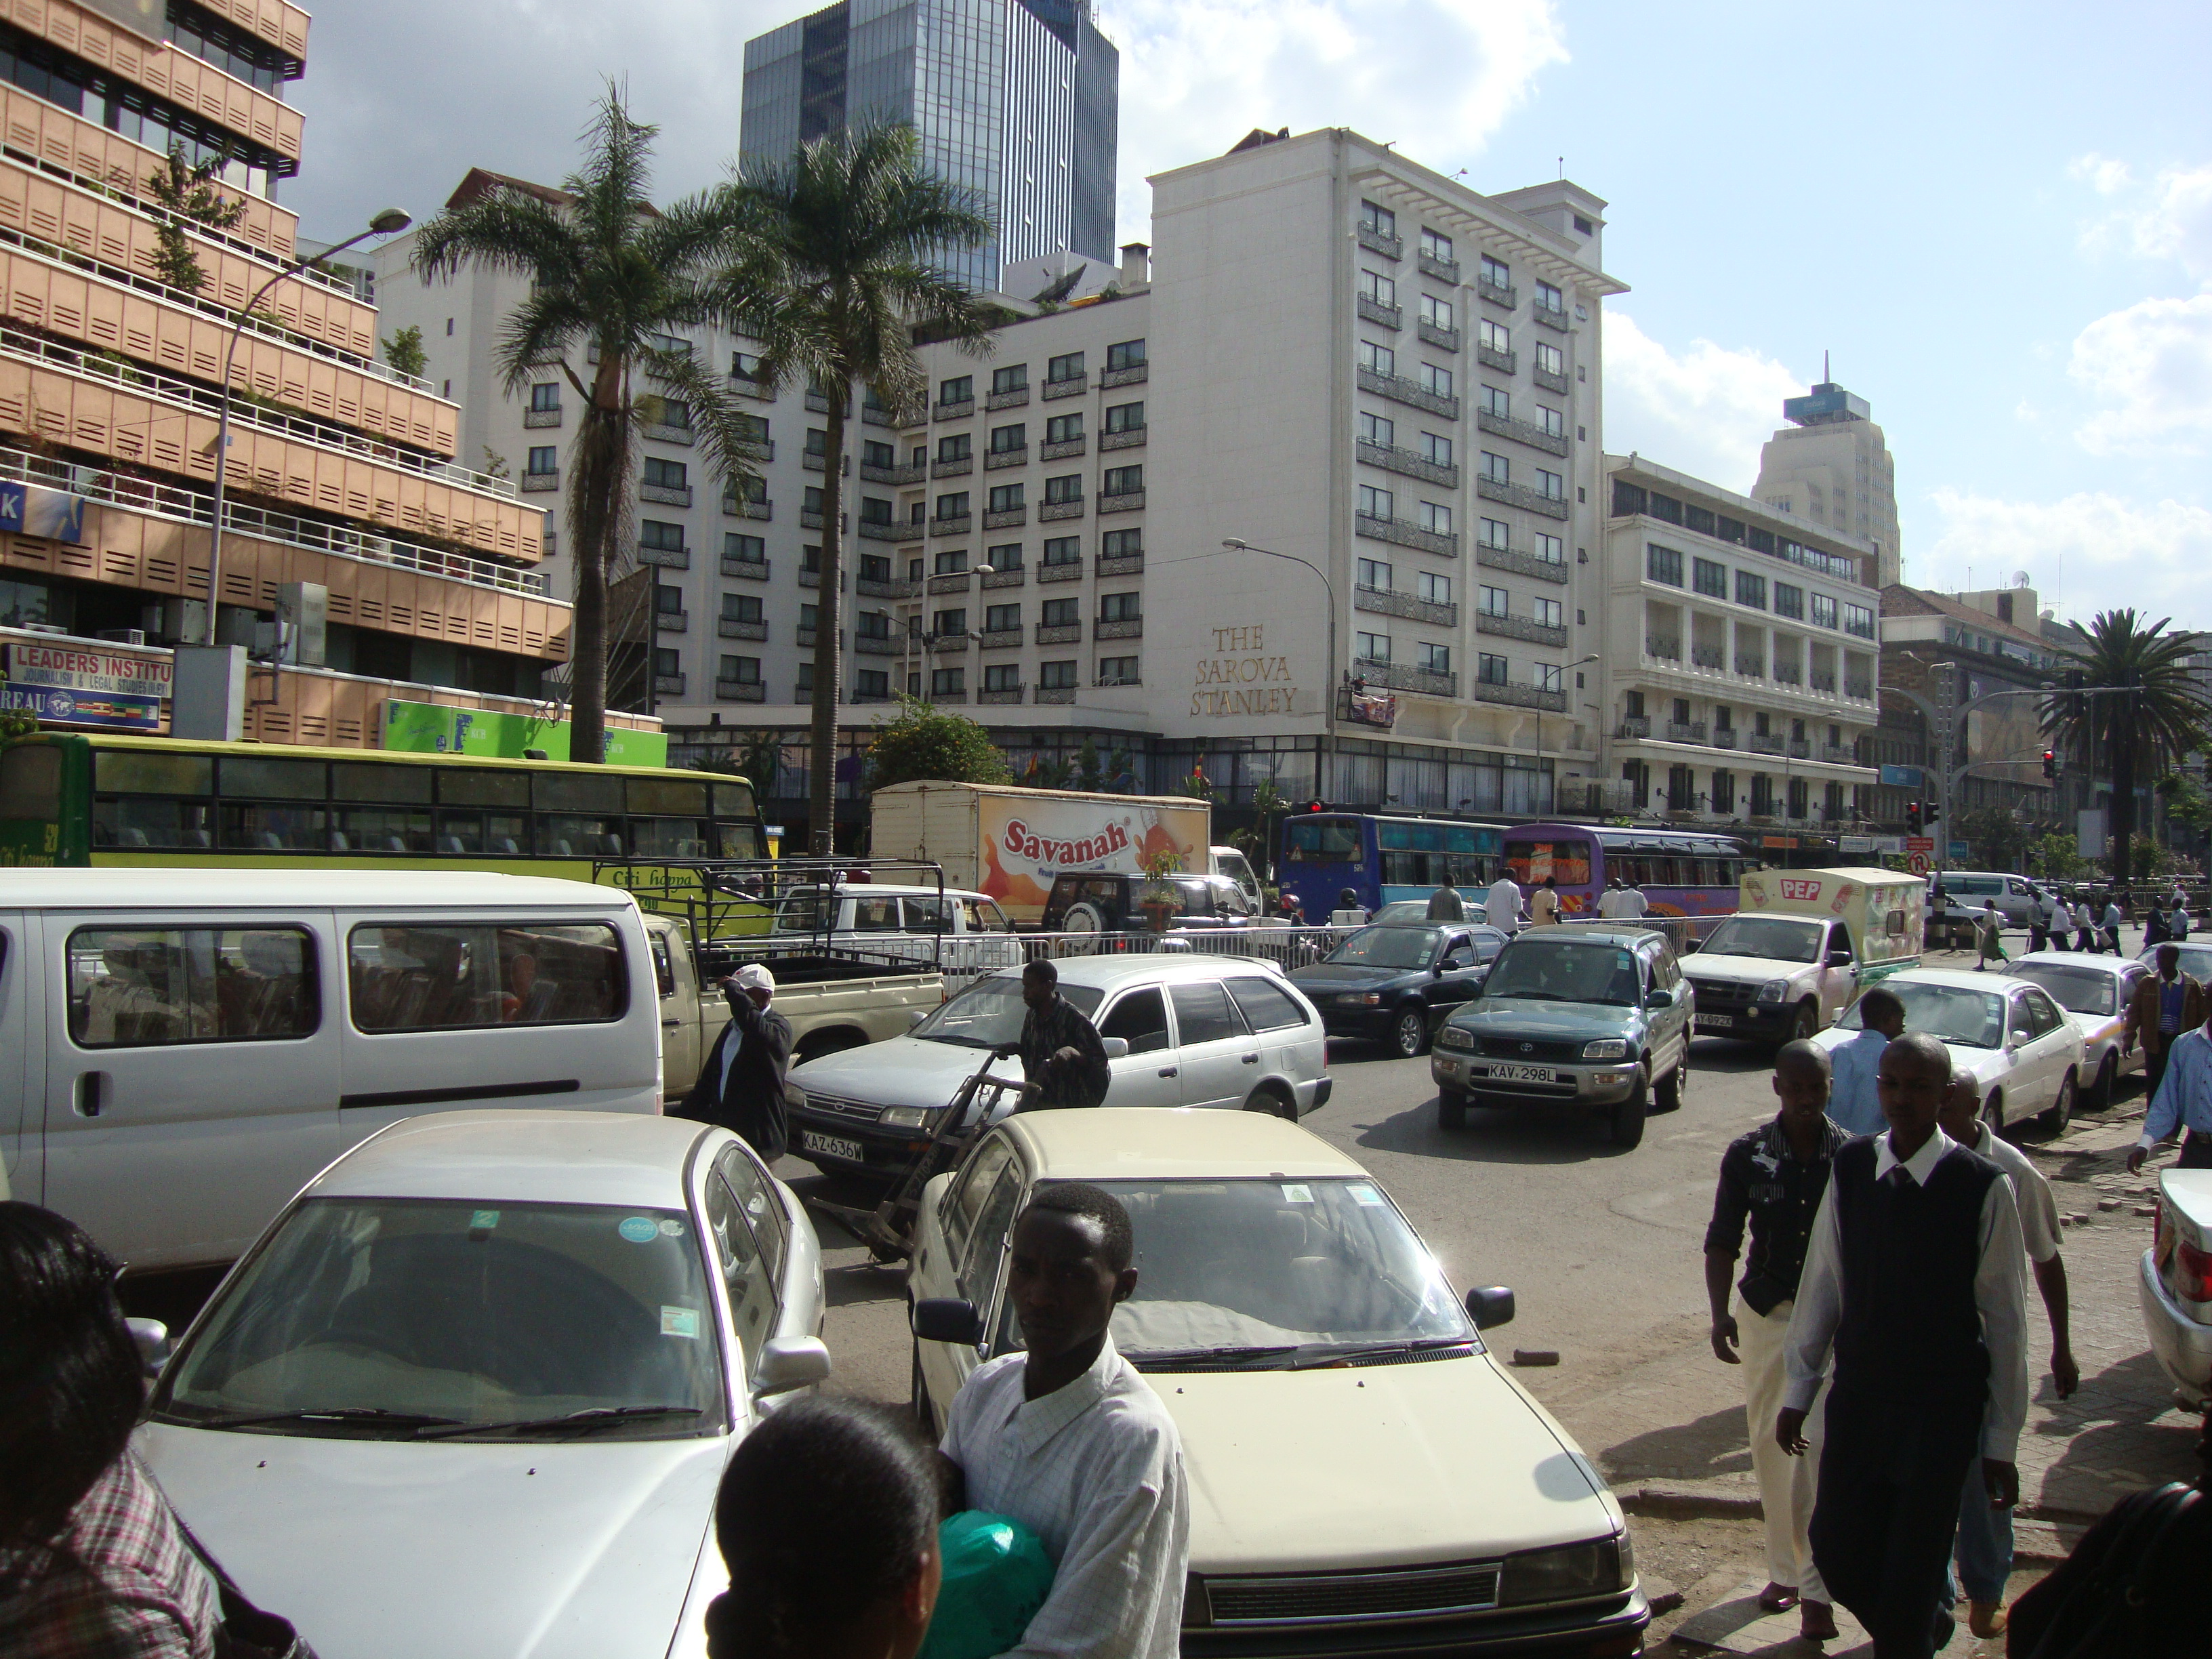
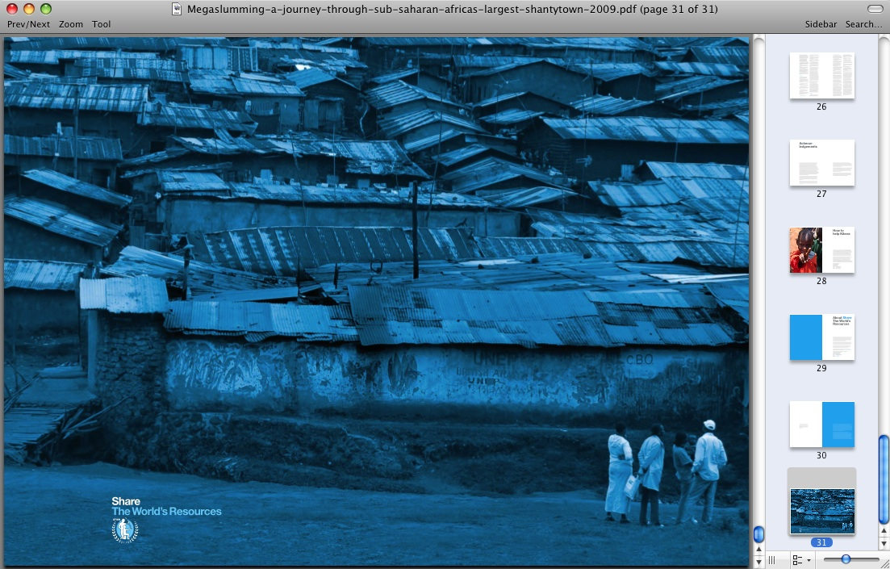
Third World Post-modernism
1.3 billion in slums today
2 billion by 2025
All population increase to slums

Slide 8
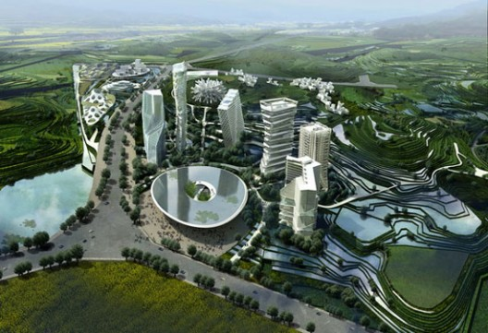
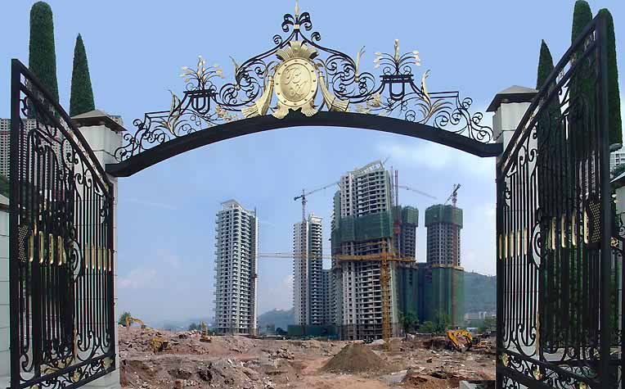
Chinese Postmod-ernism
Cities Without History
http://www.archdaily.com/category/urban-design/page/5/

Slide 9
Cities Without History
A former nation of farmers, China is halfway becoming an empire of citizens. Dusty roads are turning asphalt, carts turn into cars and concrete apartment blocks are replaced by pink and lavender condominiums. Within a decade the tidal wave of modernizations has spilled far beyond China’s coastal regions across the nation’s grey green landscape. Many thousands of villages have doubled in size and the plans for hundreds of entirely new cities are prepared and ready, awaiting execution.
http://www.archdaily.com/category/urban-design/page/5/

Slide 10
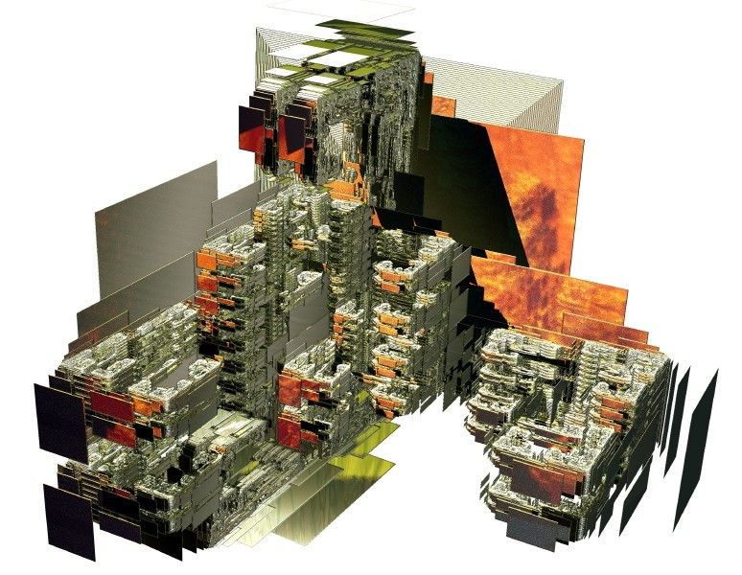
If the Kingdom Determined
Post-
Post-modern
Culture…

Slide 11
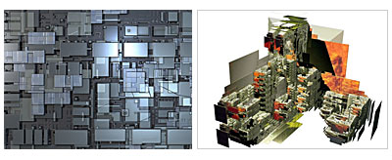
Determining values and structures of the post-Post-modernist megalopolis
Building on Evangelism and Revival, what do vision and strategies for Transformation look like?

Slide 12
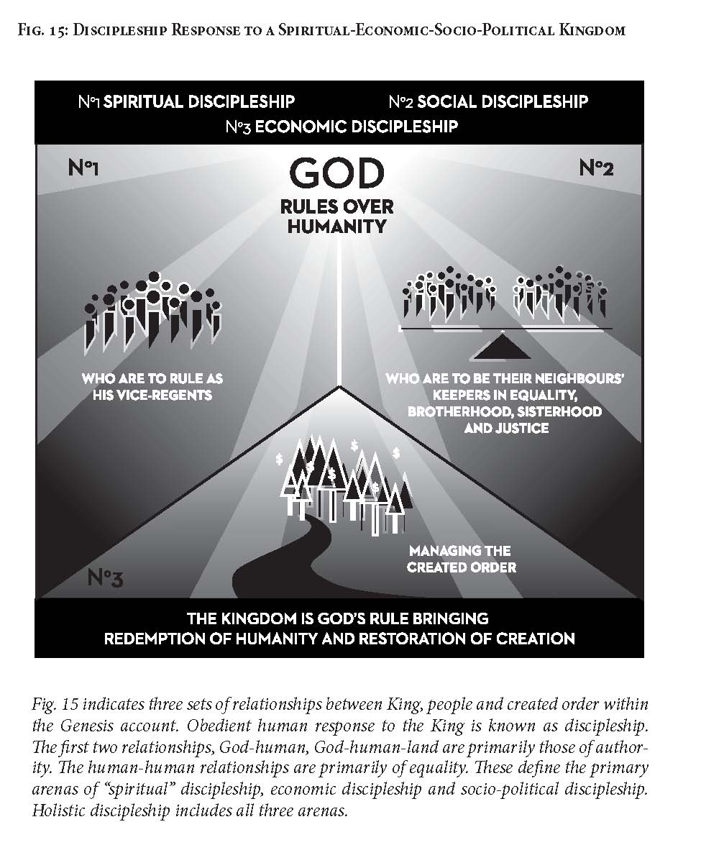
What is the Kingdom?

Slide 13
Collapsing Western Modernism

Slide 14
Transitional Vacuum of Postmodernism

Slide 15
Missions Proposal: Transitioning to Global Kingdom Cosmopolitanism

Slide 16
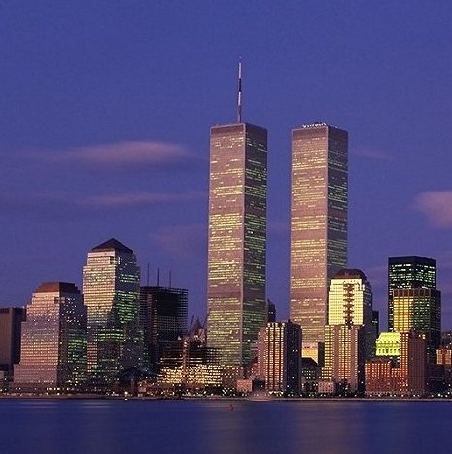
1. Reintegration Around King & Kingdom as Universal Centre
Building on Evangelism and Revival:
Post-Modernism
Loss of Authority in Govt, Academe, Religion
Incoherent Meaning
Loss of Hope
Disintegration as end of Modern Project
Individual as Autonomous
Post-post-modernism
Jesus-Integrator Authority
Coherence of Story
Future Hope
Integration (Col 1:15)
Community (He is an “Usness”)

Slide 17
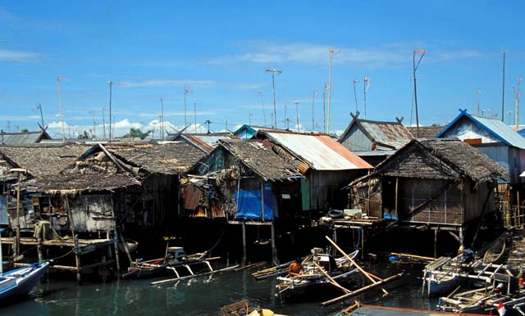
2. From a New World Order of Oppression & Destruction to an Alternative Kingdom Order
Building on Evangelism and Revival:
Defense of the Marginalized
Affirmation of Cultures, Tribes and localised self-sustaining economies
Creation of Public Space for pluralism (as in Egypt, not Libya)
Diffusion of economic, social, political power

Slide 18
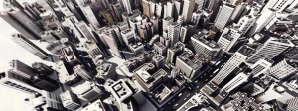
3. Personhood Infusing Matter
Building on Evangelism and Revival:
Moral Care of the Environment
Localised Cooperative vs. Capitalist Consumer Society
Personhood as Source of Energy
Working with the Expansive Creativity of Universe
Wisdom Societies Beyond the Knowledge Economies
Half of the world’s city population will be slums by 2025 - we can transform these, but we will need an evangelical and Pentecostal theology of land, land rights, and people power.

Slide 19

4. From Evolutionary Determinism to Redefinition of the Anthropo-logical
Popcorn City at Night
Owner: Aexion

Slide 20
4. From Evolutionary Determinism to Redefinition of the Anthropological
Building on Evangelism and Revival:
Devaluation of Humanness
DNA Determinism
Global McDonaldization
Fragmentation
Schizophrenia
Image as Substance
Dignity
Worth
Meaning
Hope
Community
Holism
Integrity
Half of the world’s city population will be slums by 2025 - we can transform these, but we will need an evangelical and Pentecostal theology of land, land rights, and people power.

Slide 21
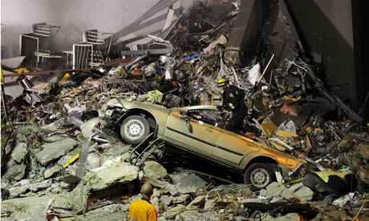

Beyond academics - prophecy informs strategy
Why would he not annihilate Los Angeles?
City of economic oppression, destroyer of families, exporter of pornography, destroyer of global cultures, centre of homosexuality, unfettered individualism, exploitative wealth disparity, into which the luxurious goods of the earth, and its prostitution pour?
If God could allow an earthquake to destroy Christchurch, New Zealand
a godly city
The Jonah Strategy: Not Transformation but Judgment: to warn the people at the centre of the Babylonian universal city culture to flee?
Why aren’t we following Jonah?

Slide 22
And God – Sovereign Judge
Why would he not destroy Los Angeles? City of economic oppression, destroyer of families, exporter of pornography, destroyer of global cultures, centre of homosexuality, leading proponent of unfettered individualism, and exploitative wealth disparity, a city into which the luxurious goods of the earth, and its prostitution pour?
If God could allow an earthquake out of the blue to destroy my university city, Christchurch, New Zealand, a godly city, more just than most any on the earth, built by the godly, lead by the godly, caring for the poor , with neither oppression nor violence, with equality and home ownership, with work, and productivity, with beauty and artistry.
The Jonah Strategy: to warn the people at the centre of the Babylonian universal city culture?
Why aren’t we following it?

